Slide 1
Module II
Process Framework Models: Capability maturity model (CMM), ISO 9000.
Phases in Software development –
  requirement analysis
    requirements elicitation(Intelligent information) for software, analysis principles, software prototyping, specification.

Slide 2
Module II
CS308 Software Engineering and Project Management
Arunvinodh C
AP, CSE

Slide 3
Process Framework
Process framework establishes the foundation of the complete software process
It identifies the small number of framework activities that are applicable to all software projects
It encompasses a set of umbrella activities, that are applicable to entire software process

Slide 4
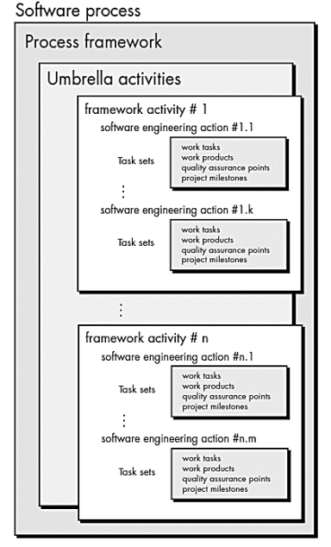
Software Process Framework

Slide 5
Umbrella activities
Umbrella activities
  It encompasses a set of framework activities
Framework activities
  Each framework activities consist of set of software engineering actions
Software engineering actions
  It is a collection of related task set that produces a major s/w engineering work product
  Example: Requirement Gathering, Design
  Each engineering action is populated with individual work task

Slide 6
Task set
It defines the actual work to be done to accomplish the objective of software engineering action
It is a collection of
  Software engineering work tasks
  Related work products
  Quality assurance points
  Project milestones

Slide 7
Case study
If Requirement Gathering is a software engineering action, then the task set of requirement gathering will be as follows
  Make a list of stakeholders of the project
  Invite stakeholders for an informal meeting
  Ask each stakeholders to make list of features and functions required for the project
  Discuss the requirements and build final list
  Prioritize requirements
  Note the area of uncertainty

Slide 8
Umbrella Activities
Framework activity 1
Software engg action 1
requirement gathering
Task set
Make a list of stakeholders if the project
Invite stakeholders for an informal meeting
Ask each stakeholders to make list of features and functions required for the project
Discuss the requirements and build final list
Prioritize requirements
Note the area of uncertainty

